Slide 1
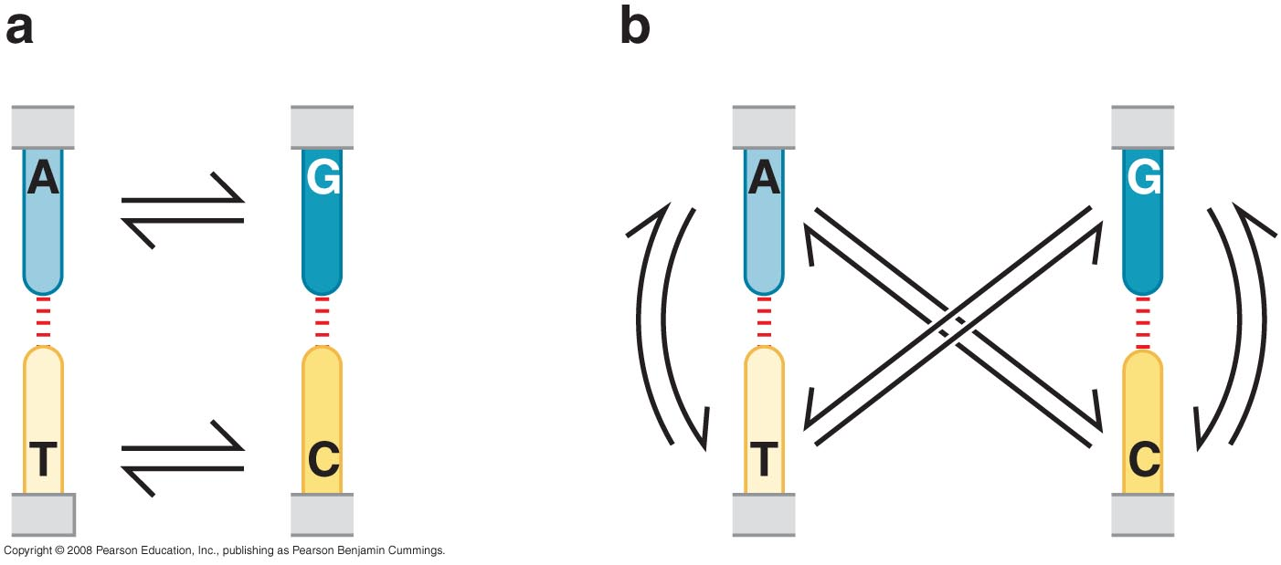
The Mutability and Repair of DNA
REPLICATION ERRRORS AND THEIR REPAIR
The nature of mutations
Transitions
Transversions

Slide 2
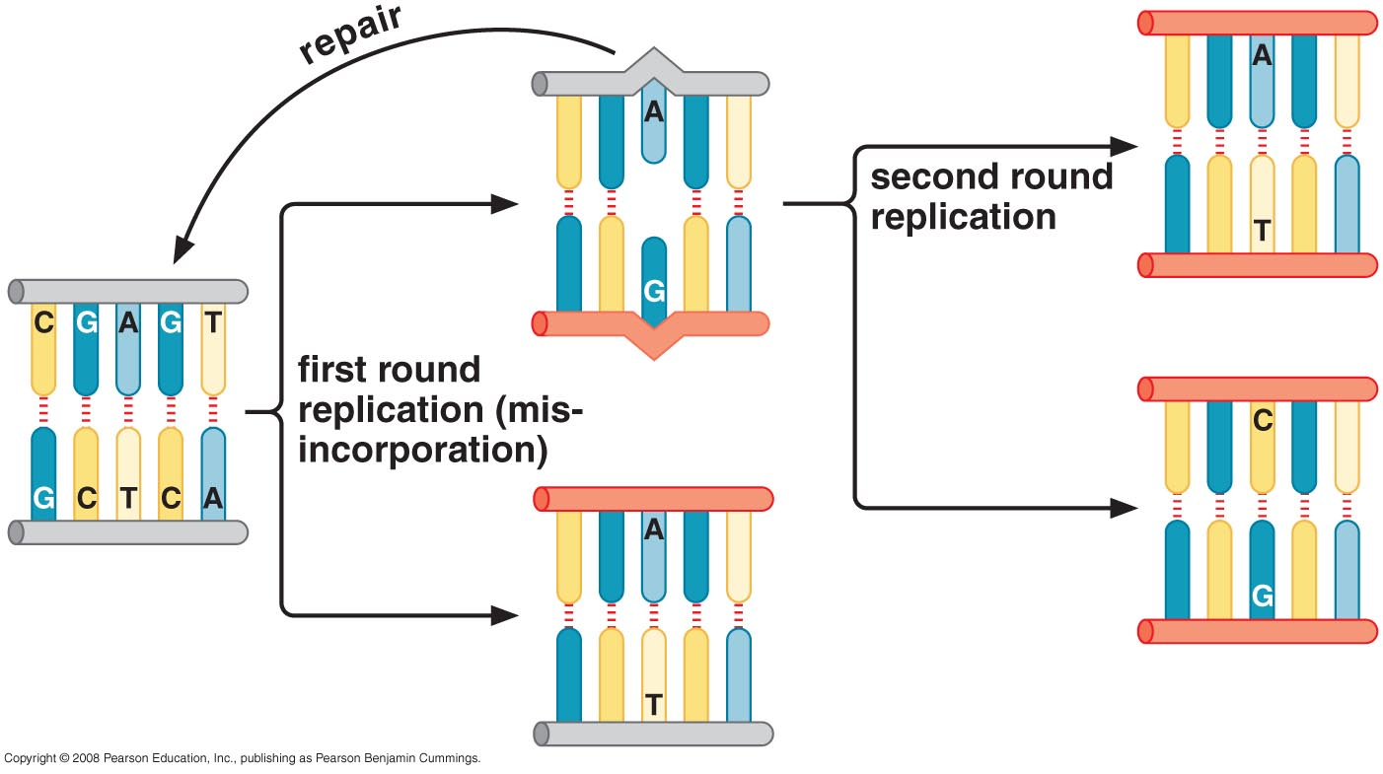
Some replication errors escape proofreading

Slide 3
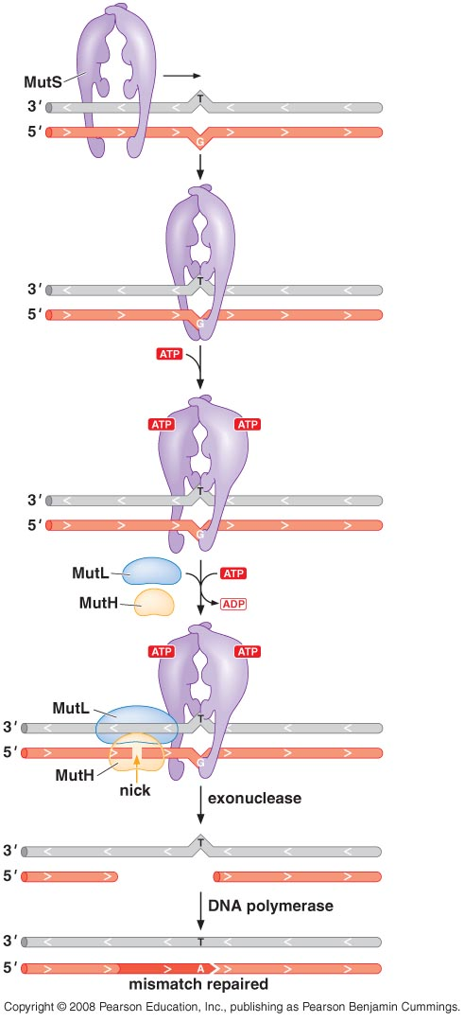
Mismatch repair removes errors that escape proofreading

Slide 4
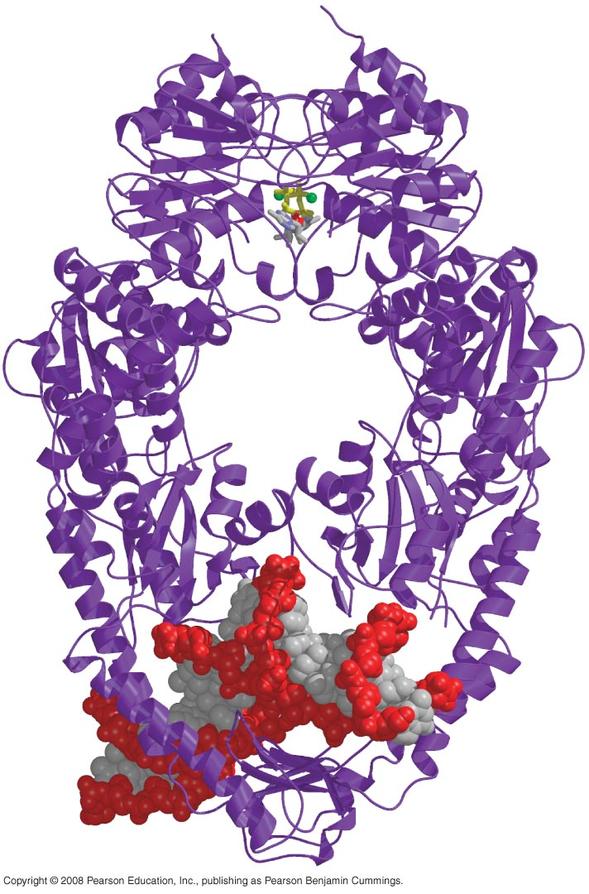
Structure of MutS and DNA
(MutS recognizing mismatches from the distortion they cause)

Slide 5
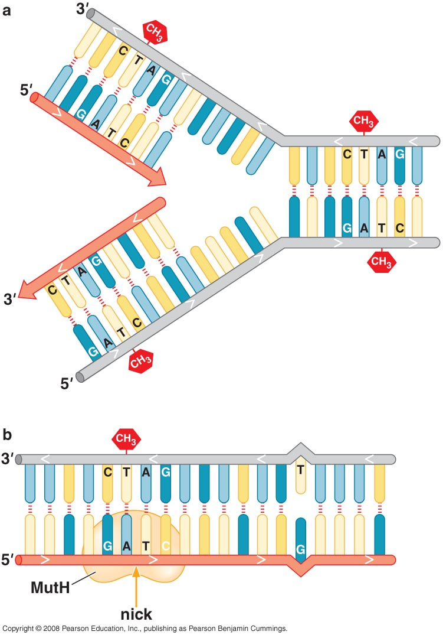
Dan methylation in E. coli replication fork

Slide 6
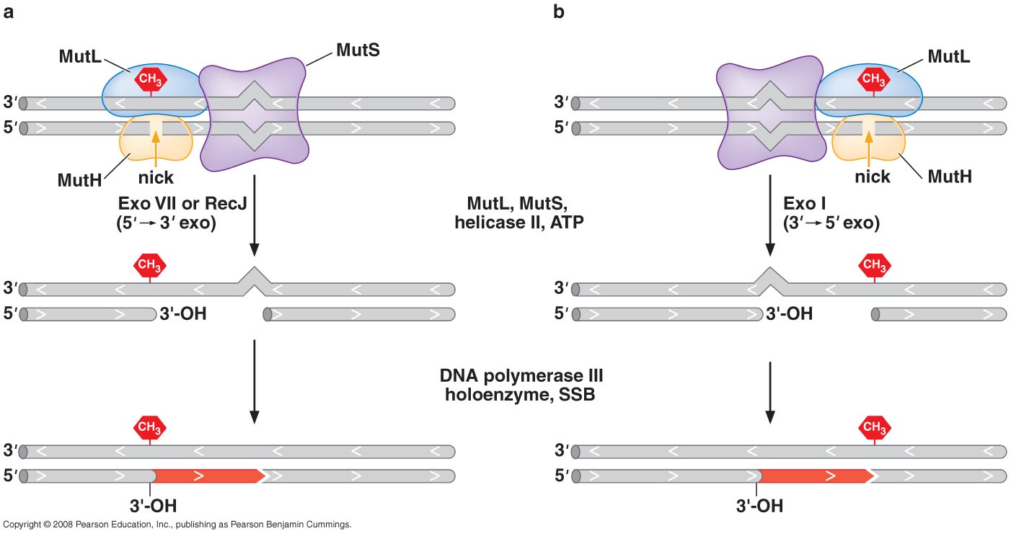
Directionality in mismatch repair

Slide 7
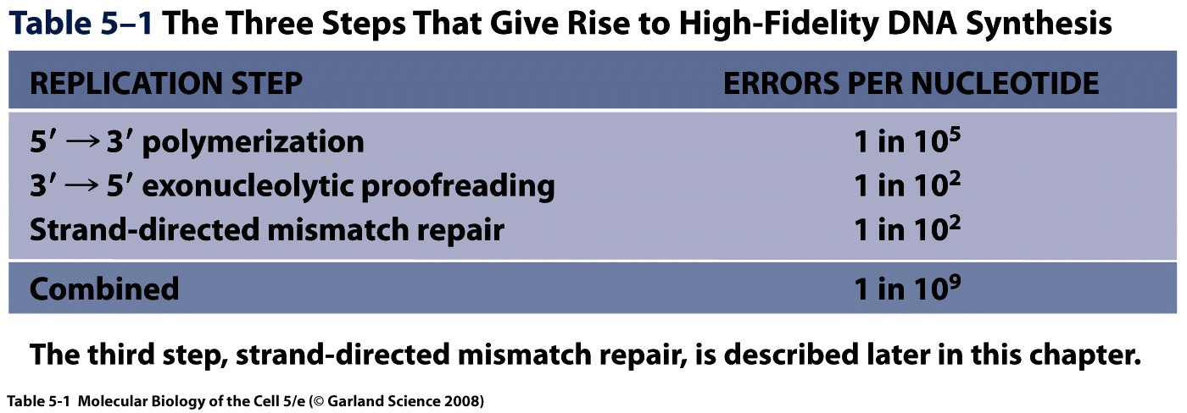

Slide 8
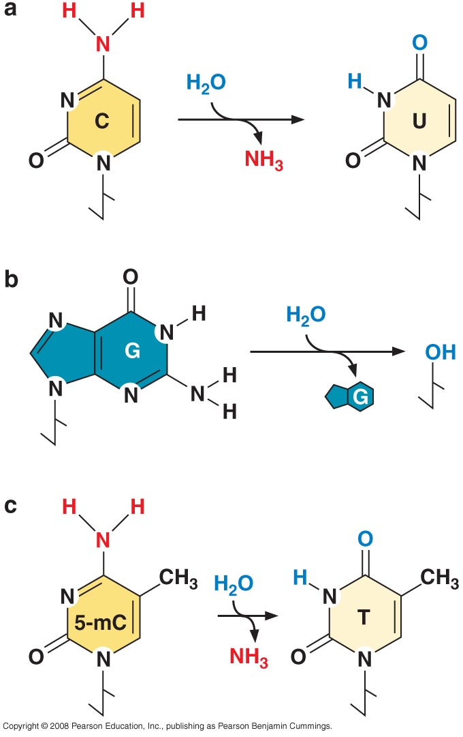
DNA DAMAGE
DNA undergoes damage spontaneously from hydrolysis and deamination

Slide 9
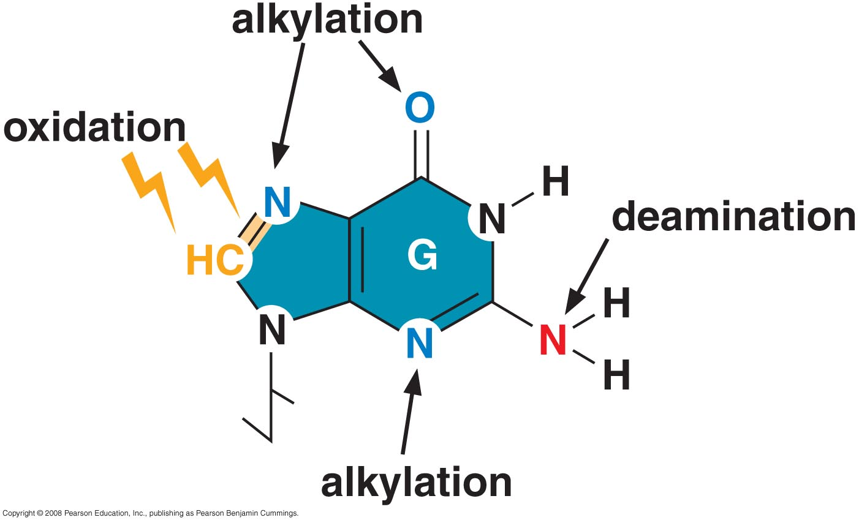
DNA is damaged by alkylation, oxidation, and radiation

Slide 10
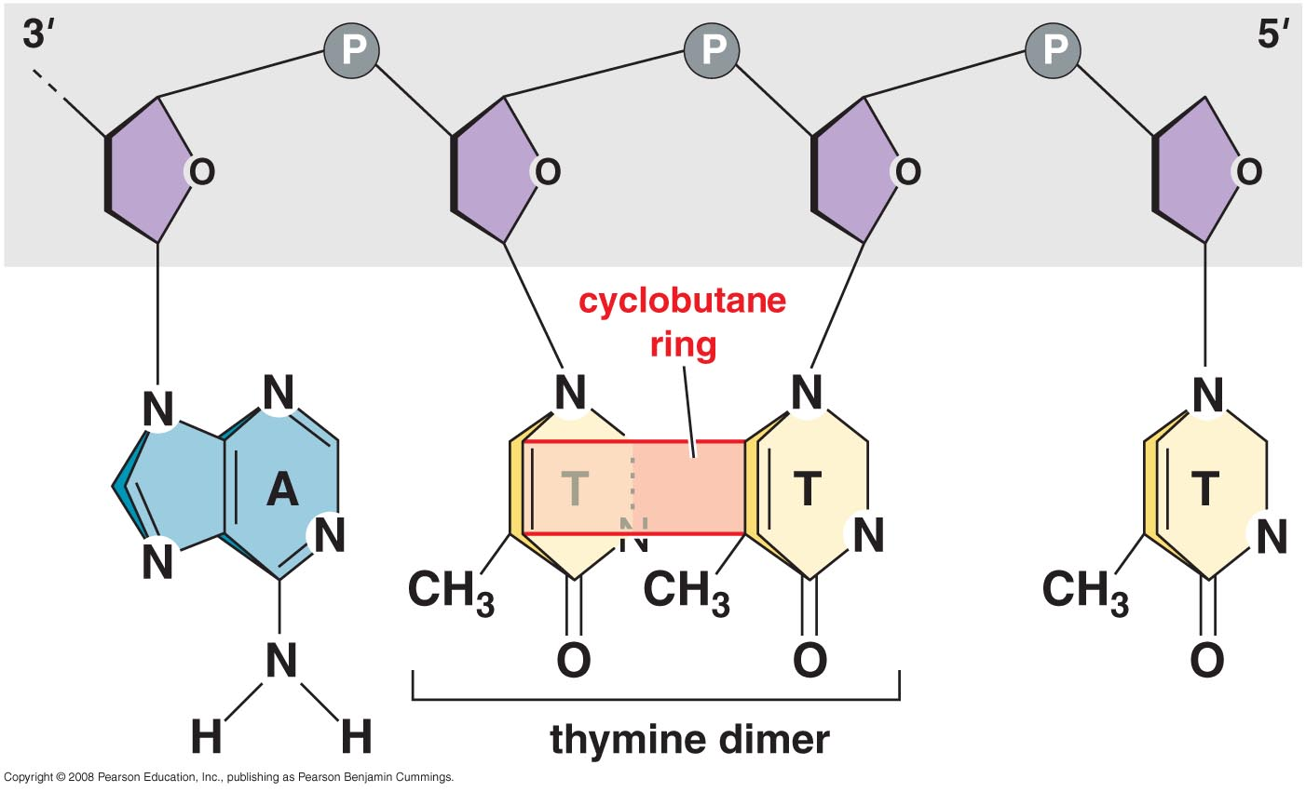
Thymine dimer caused by UV light

Slide 11
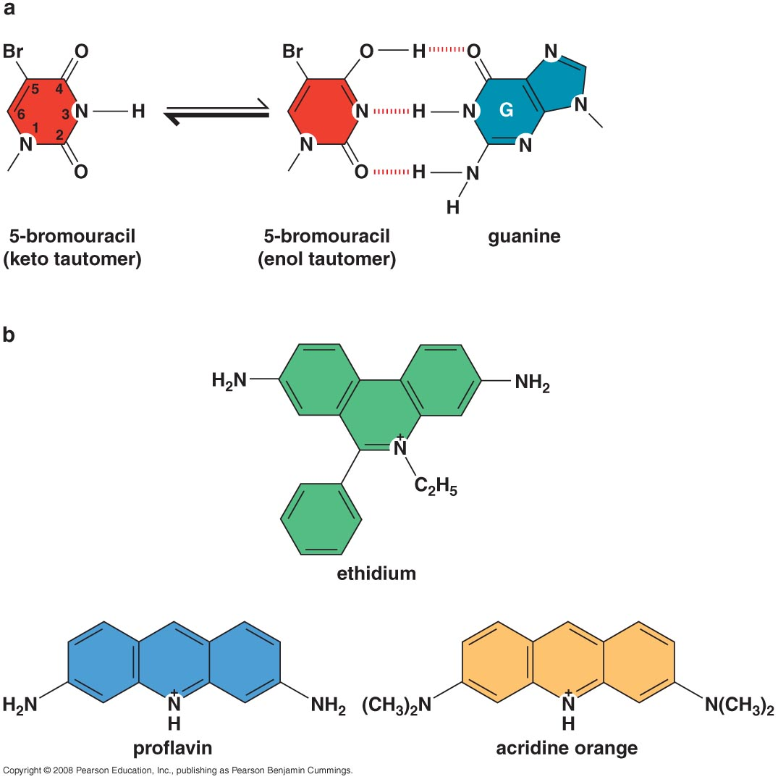
Base analogs and intercalating agents that cause mutations in DNA

Slide 12
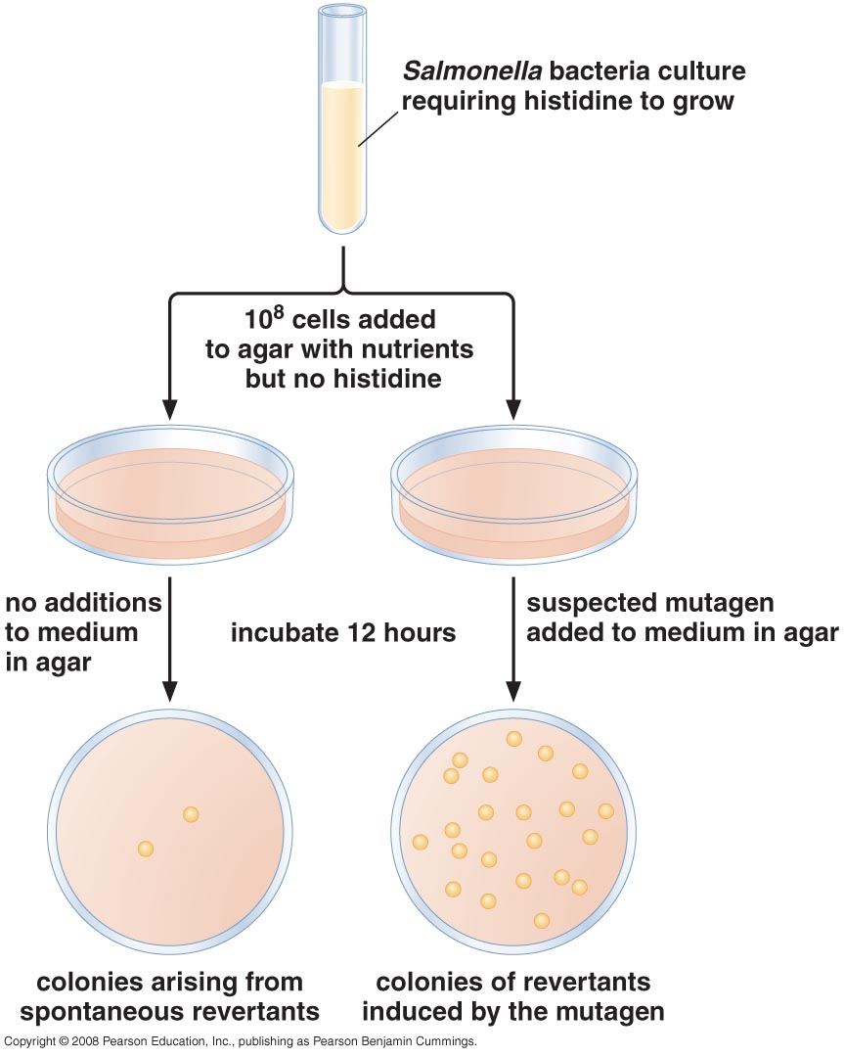
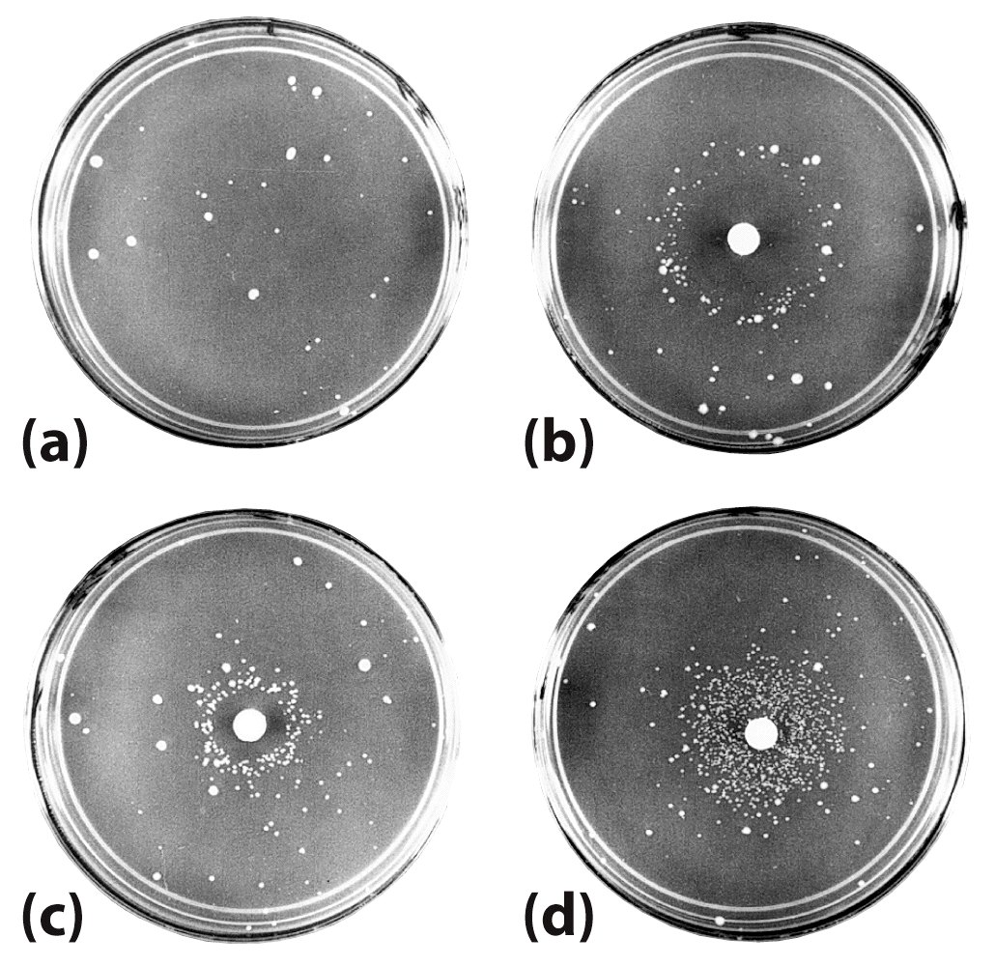
Ames test for carcinogens

Slide 13
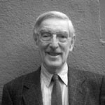
Bruce N. Ames
Professor of the Graduate School Division of Biochemistry and Molecular Biology, UC Berkeley

Slide 14
REPAIR OF DNA DAMAGE

Slide 15
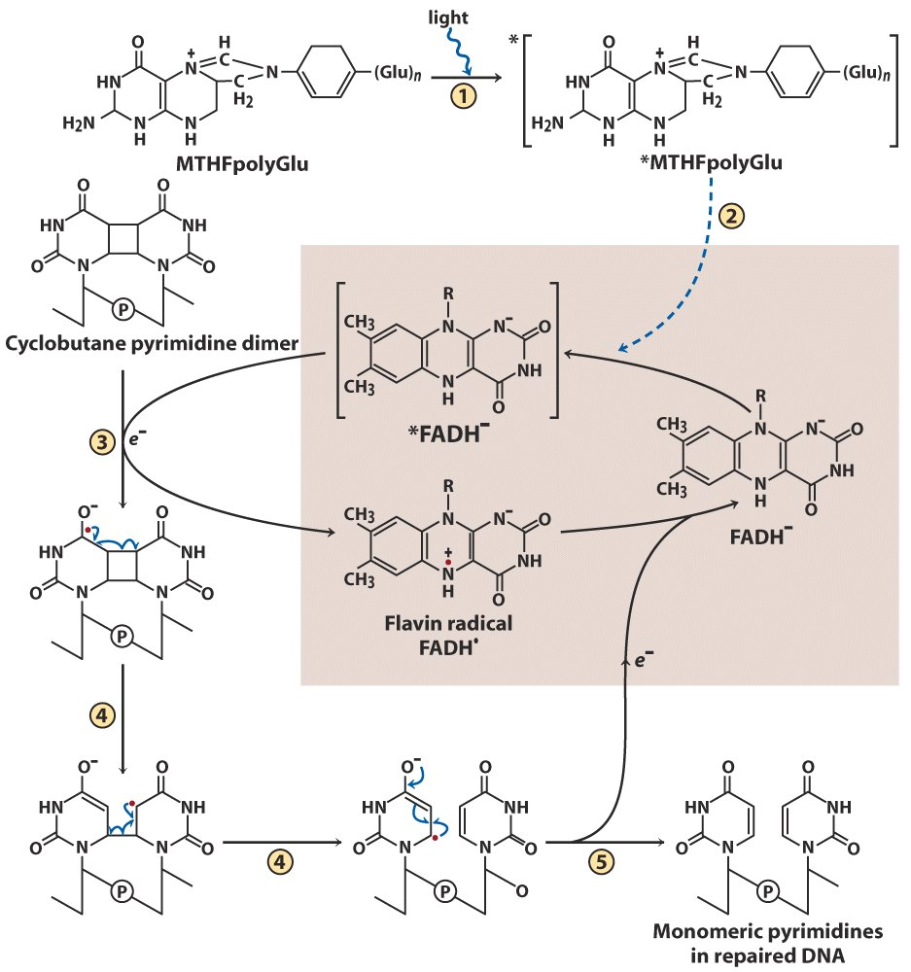
Direct reversal of DNA damage

Slide 16
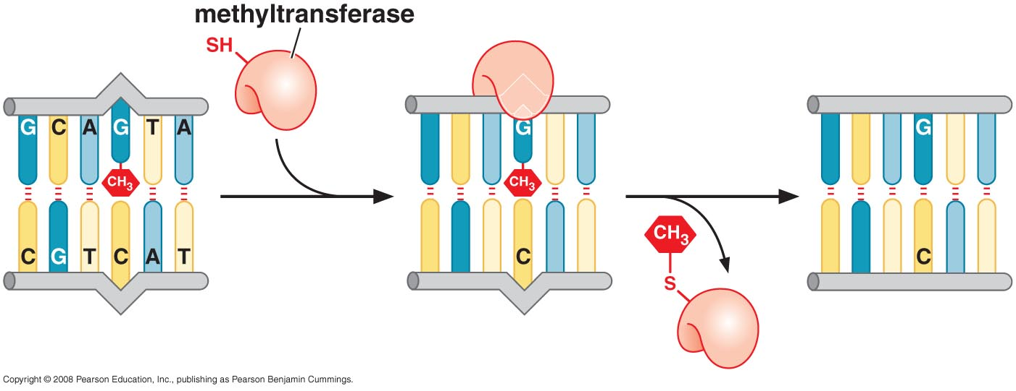
Direct removal of the methyl group from O6 -methylguanine

Slide 17
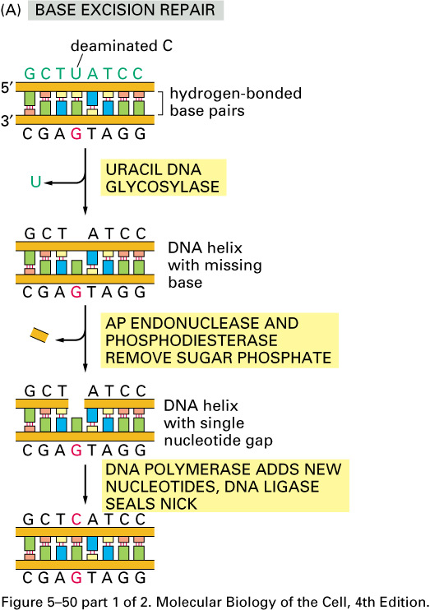
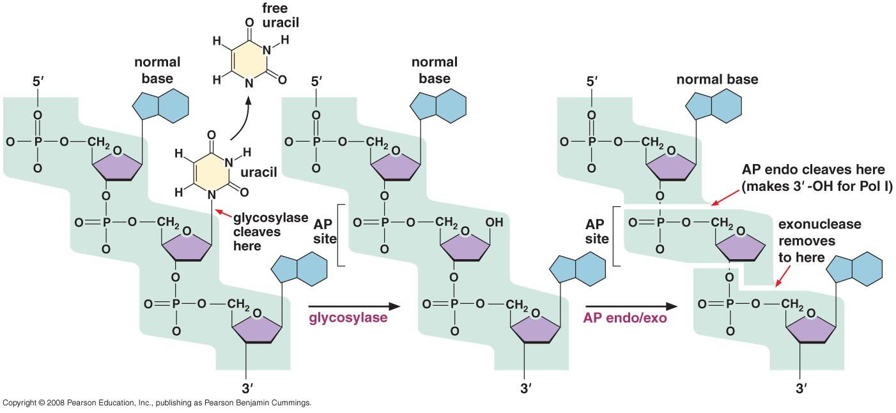
Base excision repair enzymes remove damaged bases by a base-flipping mechanism

Slide 18
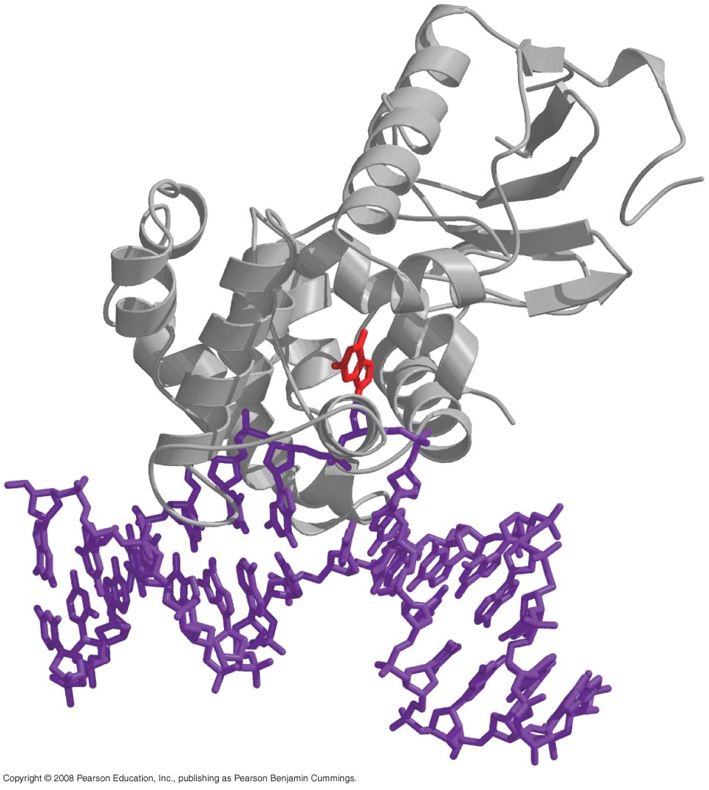
Structure of DNA-glycosylase complex

Slide 19
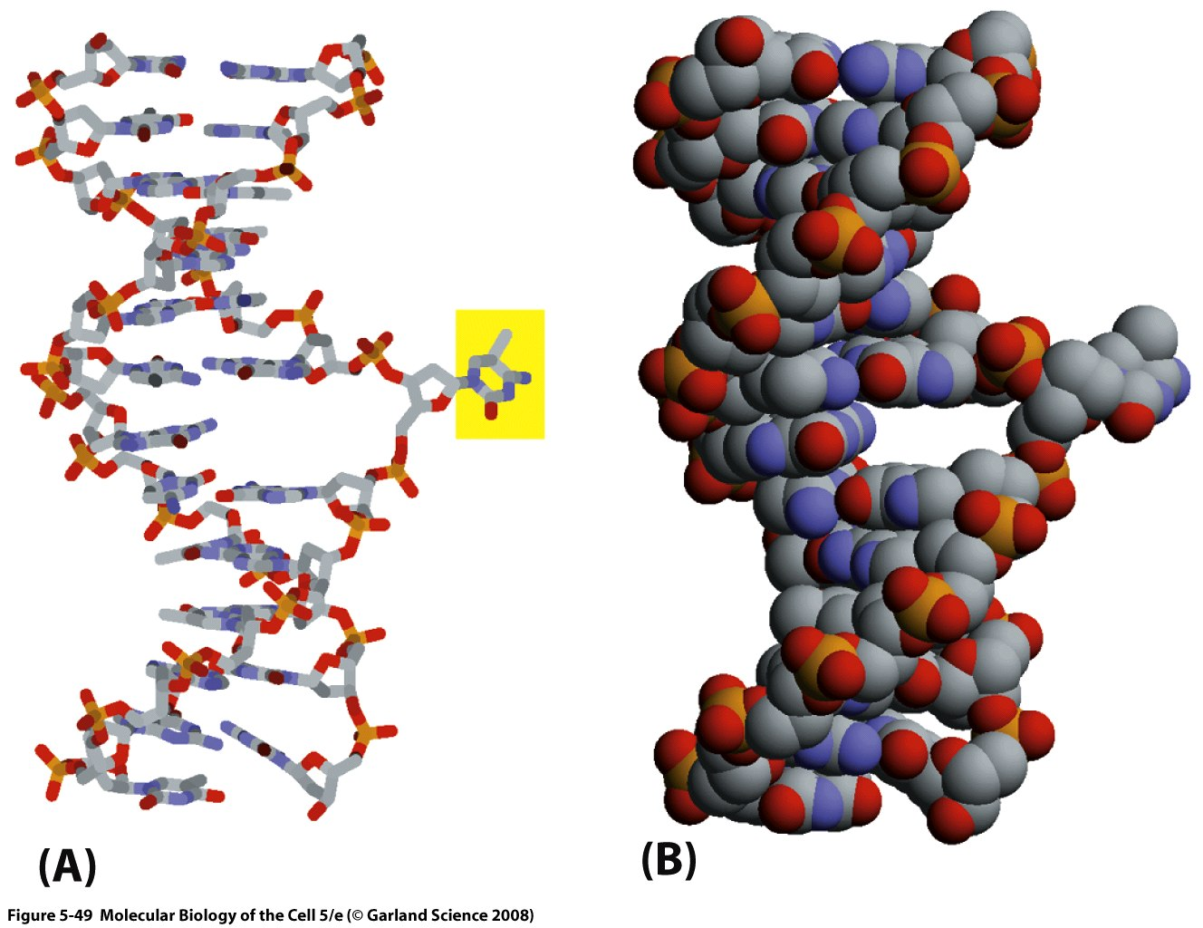
How is an altered base detected within the context of the double-helix?
The recognition of an unusual nucleotide in DNA by base-flipping of glycosylase

Slide 20
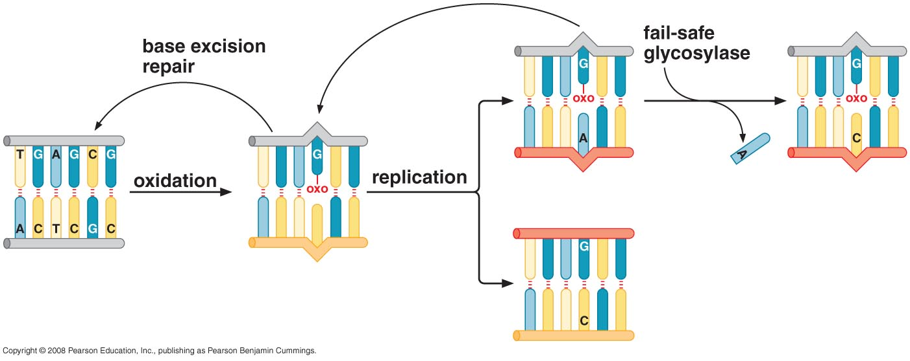
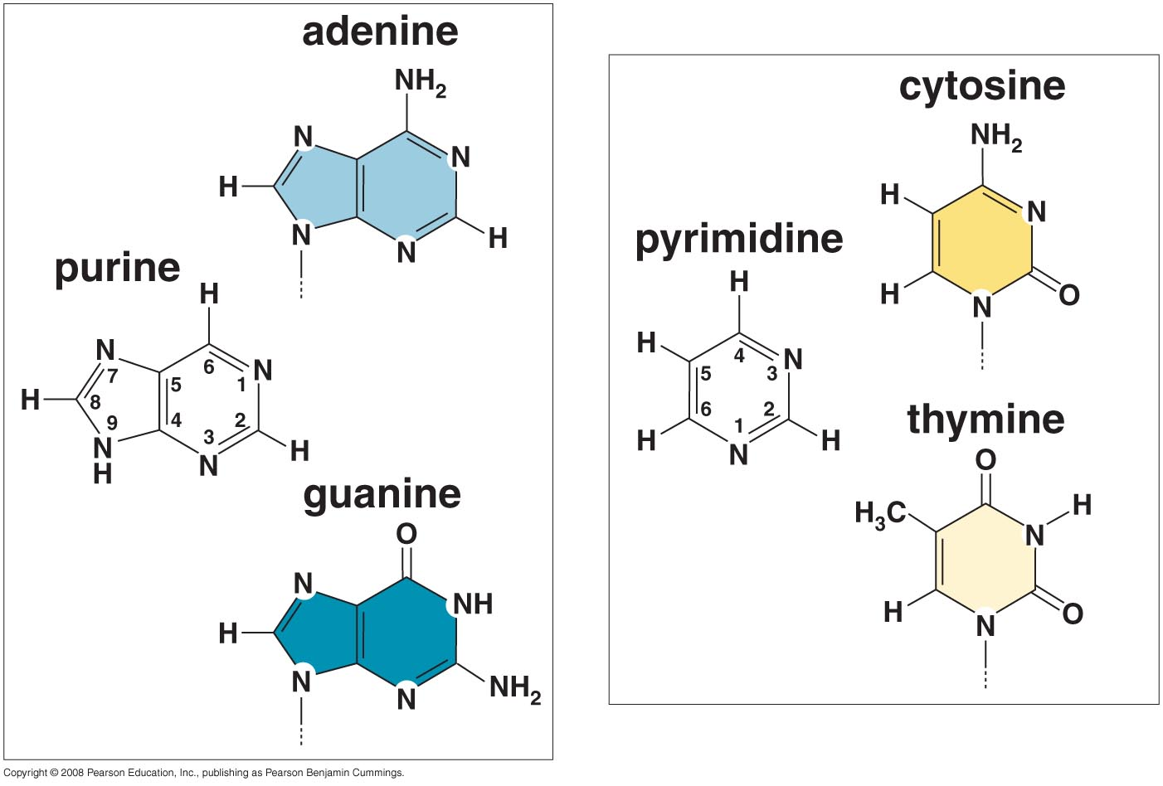
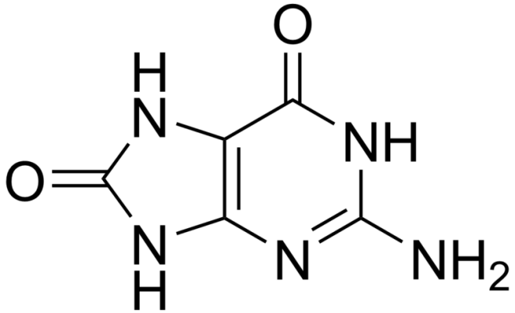
Oxo-G:A repair by a fail-safe glycosylase

Slide 21
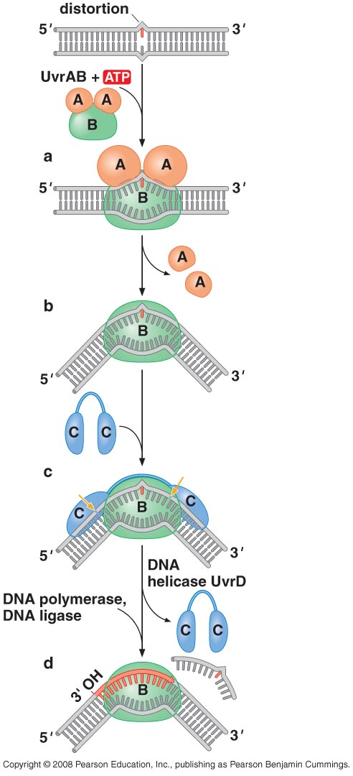
Nucleotide excision repair enzymes cleave damaged DNA on either side of the lesion

Slide 22
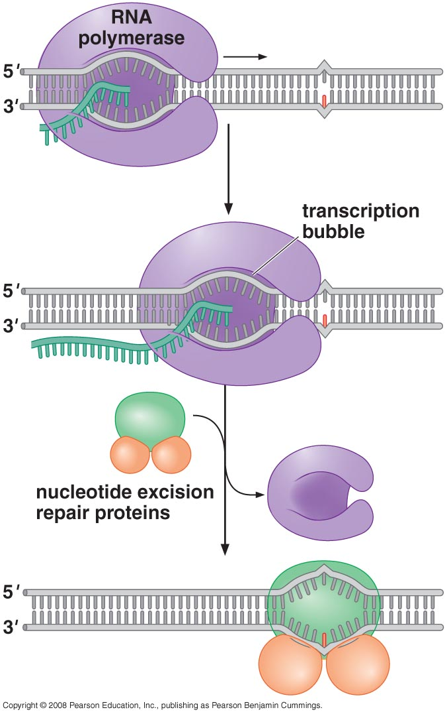
Transcription-coupled DNA repair

Slide 23
Recombination repair DNA breaks by retrieving sequence information from undamaged DNA
Double-Strand Breaks are Efficiently Repaired

Slide 24
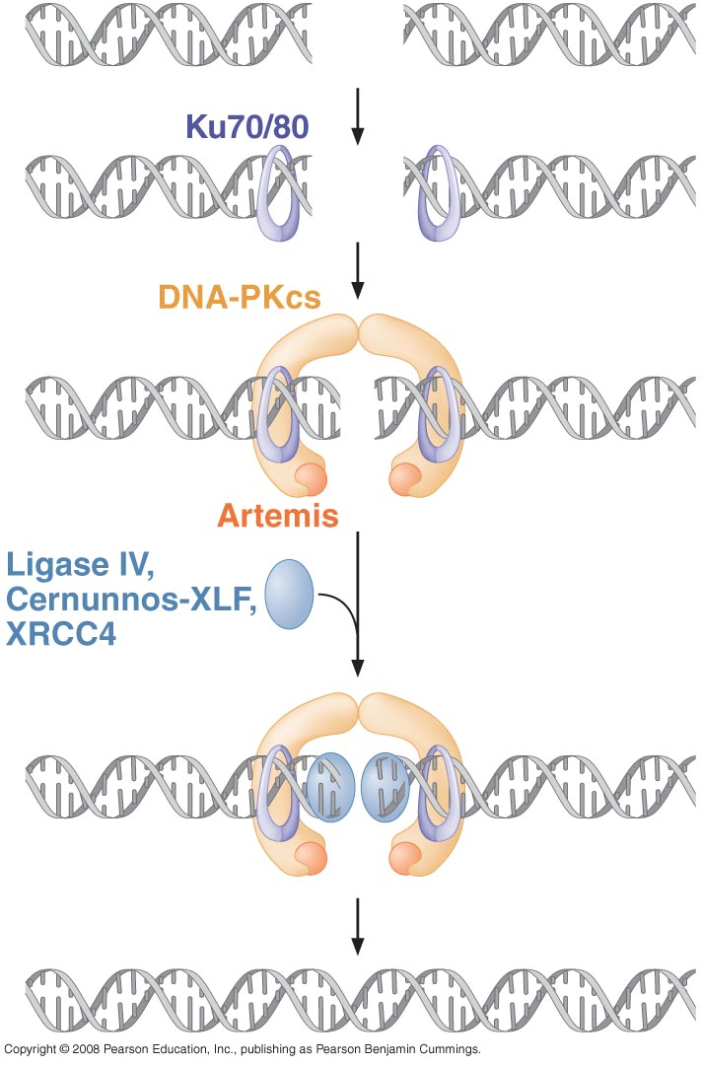
DSBs in DNA are also repaired by direct joining of broken ends

Slide 25
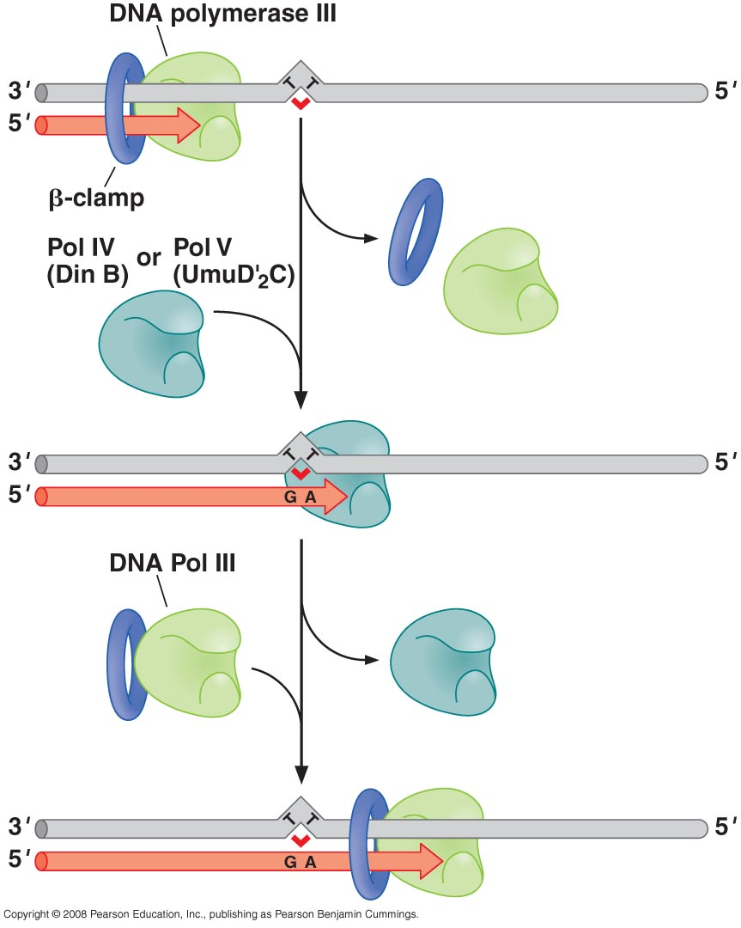
Translesion DNA synthesis enables replication to proceed across DNA damage

Slide 26
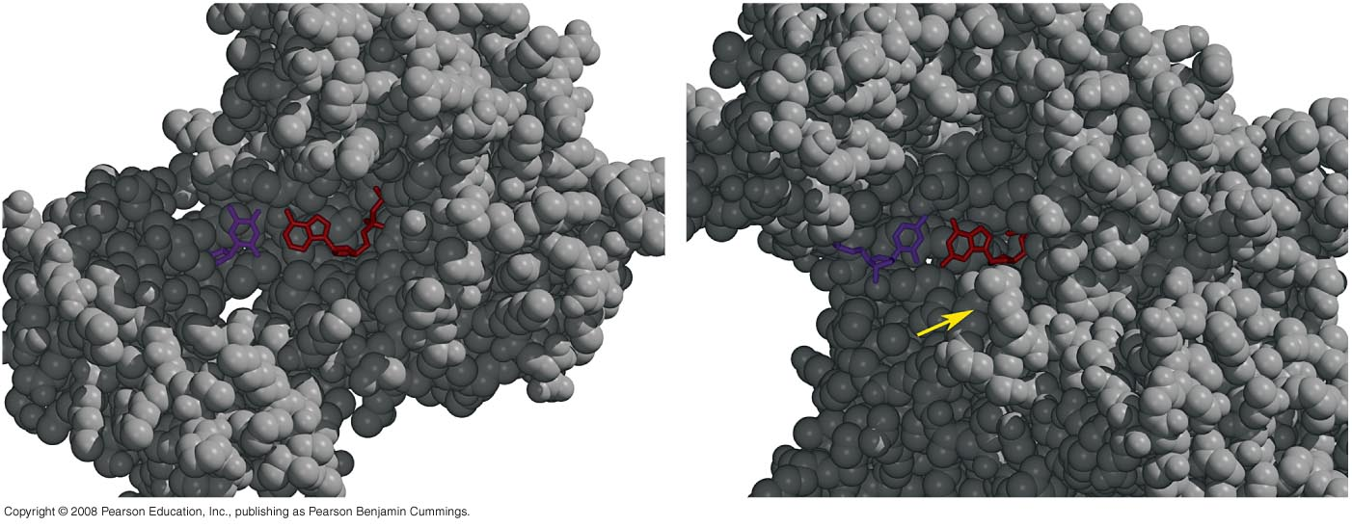
Structures of a translesion polymerase and a typical polymerase

Slide 27
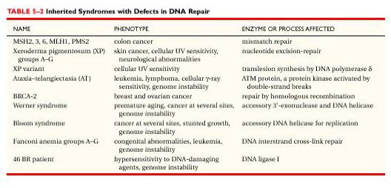
Mutations are linked to cancer

